Slide 1
Desalination Summit
Hosted by State Representative Todd Hunter
Seawater Projects In The Coastal Bend
November 2, 2017
Carlos Rubinstein
Corpus Christi, TX

Slide 2
Poseidon Water
Poseidon Water: Leading U.S. water infrastructure development specialist employing a performance-based, Public-Private Partnership approach
  Founded in 1995; headquartered in Boston, MA with presence in CA, FL, and TX
  Developer of Carlsbad Desalination Plant and other water infrastructure projects
  Majority owned by Brookfield Infrastructure Partners
Brookfield Asset Management: Global owner and operator of alternative assets
  115-year track record in real assets with a global presence (100 offices or locations; ~55,000 employees)
  $250B of assets under management (AUM) – $135B in U.S. (~11,000 employees)
  $60B in infrastructure investments: ports, water, railways, natural gas transmission pipelines, toll roads, and electricity transmission lines
  Brookfield in Texas (as of Dec. 2016):
    Assets: $15.3B AUM; ~185 projects/assets; Employees: ~915

Slide 3
What is a Public-Private Partnership (“P3”)?
A method of delivering public infrastructure in which significant risks are transferred to the private sector developer, operator, and finance partner
Single entity (“Project Company”) accepts responsibility to Design, Build, Finance, Operate, Maintain, and Transfer the assets in operating condition to the Public Partner at the end of the Contract Term
  Project Company established by Developer to implement the Project
Alignment of interests between Public and Private sector
Guaranteed on-time and on-budget performance
Accelerated delivery of critical project infrastructure
Public asset investment is protected because facility condition and performance is guaranteed for a long-term period (30 to 50 years)
Provides greater “value-for-money,” reflecting the added value of risk transfer (operation, maintenance, compliance, delivery, etc.) using a P3 approach as compared to a traditional project delivery
12/1/17

Slide 4

Typical Project Structure
Key
Agreements
Payments
Off-taker/Water Authority
Debt Provider: Bond Investors or Banks
Management
Services
Agreement
Water
Purchase
Agreement
Project
Revenues
Equity
Contribution/ Distributions
Debt
Proceeds/ Repayments
Shareholder
Agreement
Project Company
Loan
Agreement
EPC Agreement
O&M Service Agreement
Engineering, Procurement,
and Construction Contractor
Operations & Maintenance Provider

Slide 5
Poseidon | Carlsbad Project Overview
  Project Capacity: 54 MGD Desalination Plant and a 10-mile, 54-inch pipeline serving San Diego County
Technology: Seawater Reverse Osmosis
Delivery Method: Design- Build- Finance- Own- Operate- Maintain- and Transfer
Total Capital: $922 million financing closed in 2012
Commercial Operations Date: December 2015, delivered on-time and on-budget
Status: Delivered 22⁺ billion gallons of drinking water to date
Largest Desalination Plant in the Americas

Slide 6
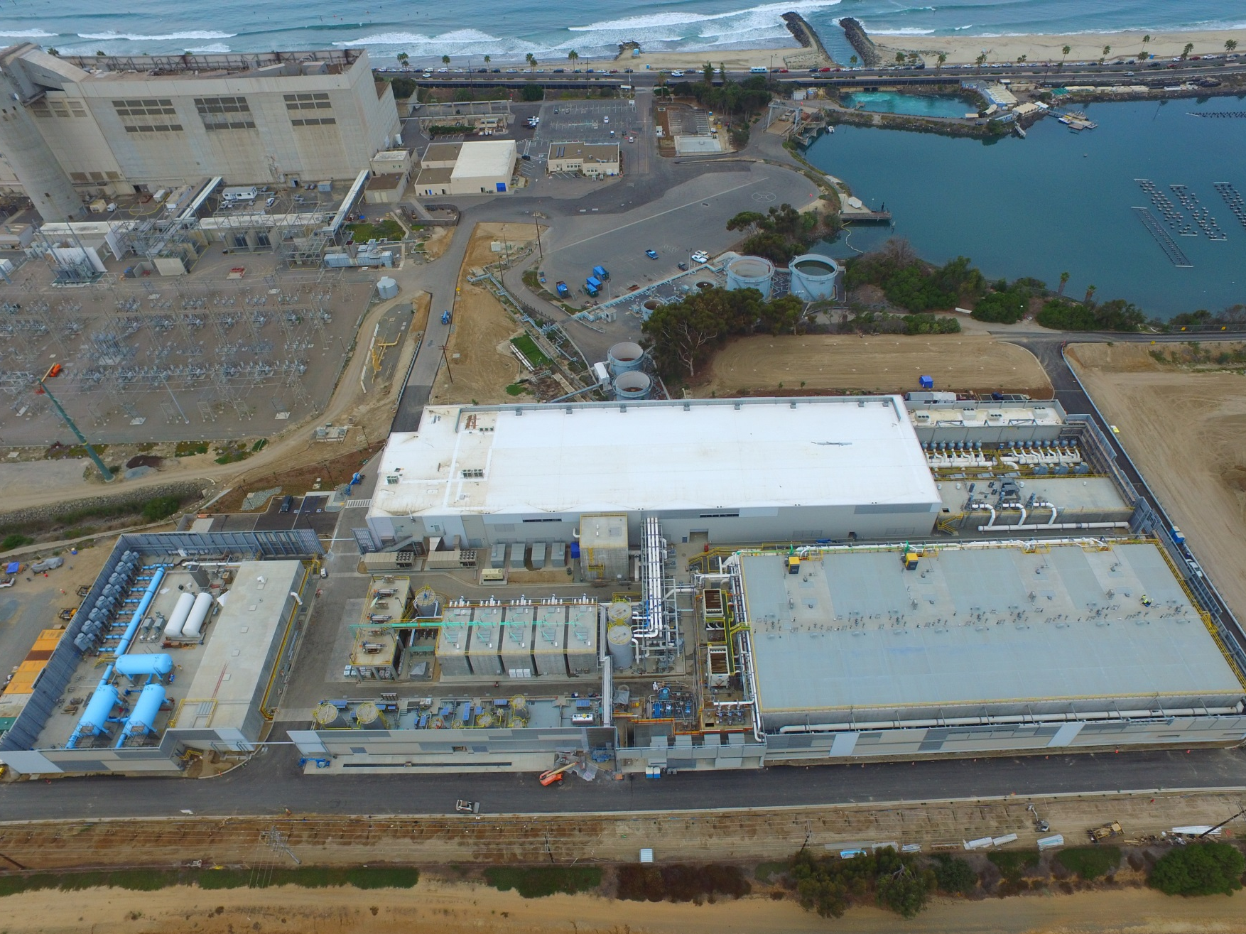

Slide 7
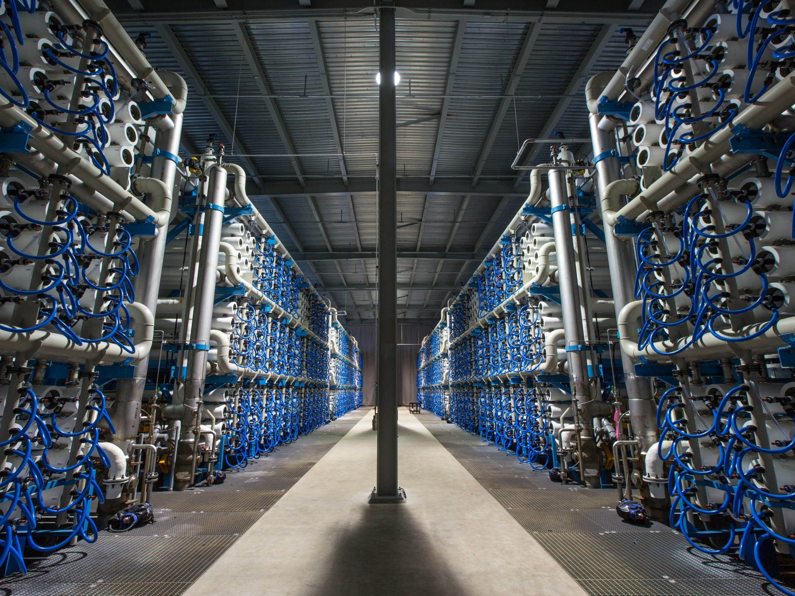

Slide 8
Challenges & Project Benefits
Challenges for San Diego County Water Authority (“SDCWA”)
  High reliance on surface water
  Future water demand increases
  No single resource strategy can manage all uncertainties
  Usage restrictions during times of drought
Desal Project Supply Benefits to the region
  Locally-controlled, drought-proof supply of high quality water
  Reliability/Insurance against drought/unforeseen events
  Key element of water supply diversification strategy
  Reduces demand on sensitive water bodies
Similar Dynamics in and along the Texas Coast

Slide 9
Texas River Basins
Upstream benefits of desalination

Slide 10
Texas Desal Legislation | 2017
SB 1430 (Sen. Perry/Rep. Lucio III), proposed by Poseidon, took effect on September 1st, 2017
  Expected to strengthen incentives for the creation of desalinated seawater supplies along the state’s 367-mile coastline by:
    Streamlining and expediting the permitting process to extend benefits upstream
    Provides that the holders of water rights in any Texas river basin will be entitled to an expedited permit amendment of their existing water rights by the Texas Commission on Environmental Quality (TCEQ) when they diversify their water supply to include seawater desalination
    Applications subject to a hearing, applicants will be entitled to a decision within 270 days on proposals to move their surface water diversion point(s) upstream within the same river basin
    The law does not provide those benefits to the transfer of water rights from one river basin to another

Slide 11
Questions?
_____________________________________________________________________________________________________________
Carlos Rubinstein – crubinstein@poseidonwater.com

