Slide 1
Corpus Christi
Seawater Desalination
Desalination Summit
2 November 2017

Slide 2
What Motivated Initial Interest in Seawater Desalination?
Period of prolonged drought and increased economic activity…
Desire to reduce risk of water rationing / curtailment to industrial operations
Concern that available water supply was impacting competitiveness of region in attracting new industry and expansions
Interest in diversifying and strengthening the region’s water supply through development of a drought-proof source

Slide 3
Desal Group Partners – “The Stakeholders”
Corpus Christi Regional EDC
City of Corpus Christi
San Patricio MWD
Port of Corpus Christi
Chemours
Cheniere Energy
CITGO
Flint Hills Resources
Lyondell-Basell
OxyChem
Sherwin Alumina
Valero
voestalpine Texas
AEP Texas
Talen Energy
Engineering and Technical Consultants:
Lead: Freese and Nichols, Inc.
Team: Jorge Arroyo, Water Globe Consultants, The Louis Berger Group, The Banister Group, Assistant Energy Manager, Naismith Engineering, Olivarri and Associates

Slide 4
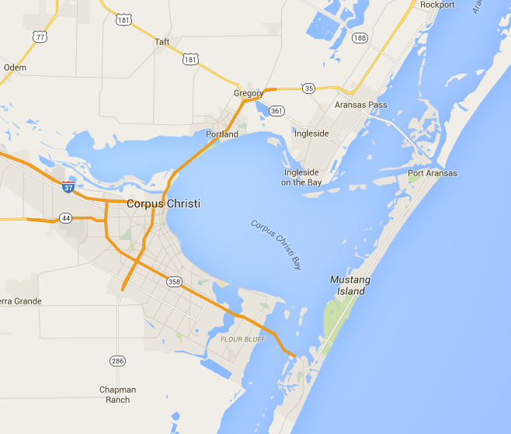
Siting

Slide 5
Configurations Developed/Assessed
Desalination Plant – 6 options (4 @ 20 MGD; 2 @ 10 MGD)
Distribution Pipeline Arrangement – 12 options
Gulf Discharge Pipeline ($70+ million)
Organizational Structure (Public, Private, Blend)
Pre-Procurement Development Strategy (Early or Late Exit)
Financing Options (Public, Private)
Project Delivery Methods (DB, DBO, DBOM, DBFOM, etc.)
DB: Design-Build
DBO: Design-Build-Operate
DBOM: Design-Build-Operate-Maintain
DBFOM: Design-Build-Finance-Operate-Maintain

Slide 6
Concept
10-30 MGD (dependent on demand profile)
Expandable
Running at full output all the time (no throttling)
Desalinated water treated to potable standards
Delivered to the Regional Water System
Seek funding through SWIFT
Procurement method: Design-Build, or Design-Build-Operate
 | Inner Harbor | La Quinta | Both
Cost to Produce ($/1000 gal) | $ 3.78 | $ 3.76 | $ 3.77
Cost to Distribute ($/1000 gal) | $ 0.24 | $ 0.21 | $ 0.22
Delivered Cost of Desalinated Water ($/1,000 gal) | $ 4.02 | $ 3.97 | $ 3.99
Cost of Capital: 3%, 30-yr
25% Contingency
Power at 5¢/kw-hr
Project development, administration, organizational costs and studies estimated in the $10-12 million range for 20 MGD project…scaled down to $8 million for 10 MGD project

Slide 7
Timing Is Everything!
Key Factors Affecting Project Timing
Supply
Demand
Lead Time

Slide 8
Development Approach
SWIFT 1
SWIFT 2
Pre-Development
Project procurement methodology
Concentrate mgmt strategies
Site selection and surveys
Source water characterization
Confirm plant size and point of delivery
Infrastructure integration plan
Intake / Outfall concept design
Power supply agreement
File owner’s permit applications
Procurement, Contracting, Delivery
Bid package
Statement of qualifications
Request for proposals
Selection
Contracting
Water purchase agreement
Delivery
Trigger Ready

Slide 9
Thank You
Questions

