Slide 1
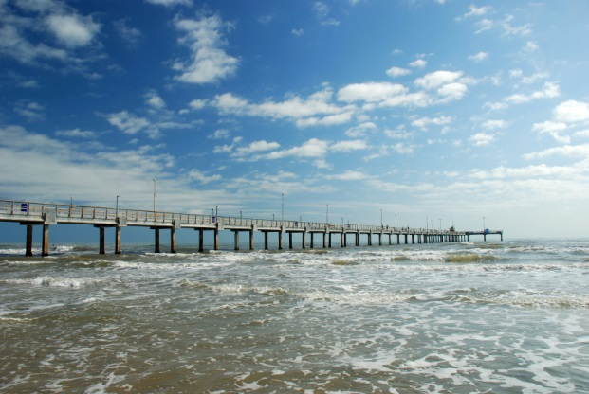
WATER for TEXAS Water for the Future
Kathleen Jackson, P.E. Desalination Summit
November 2, 2017

Slide 2
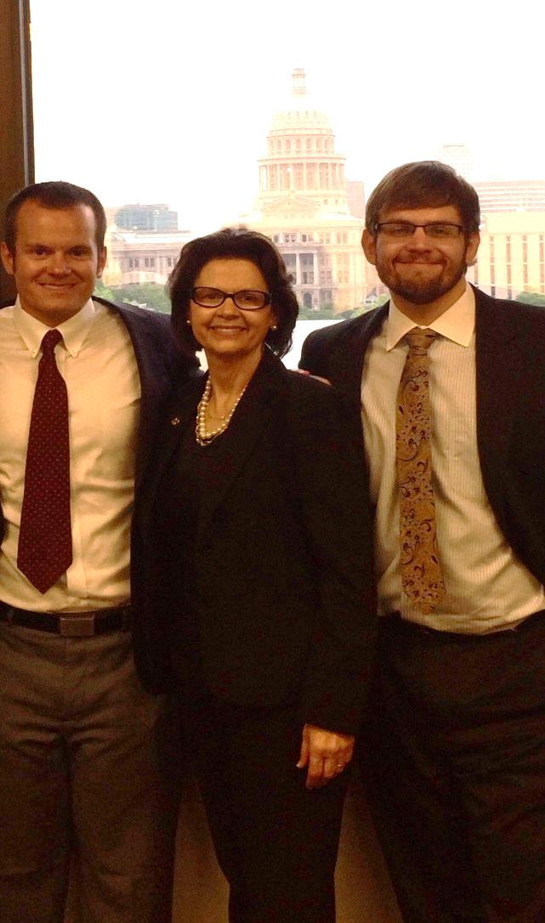
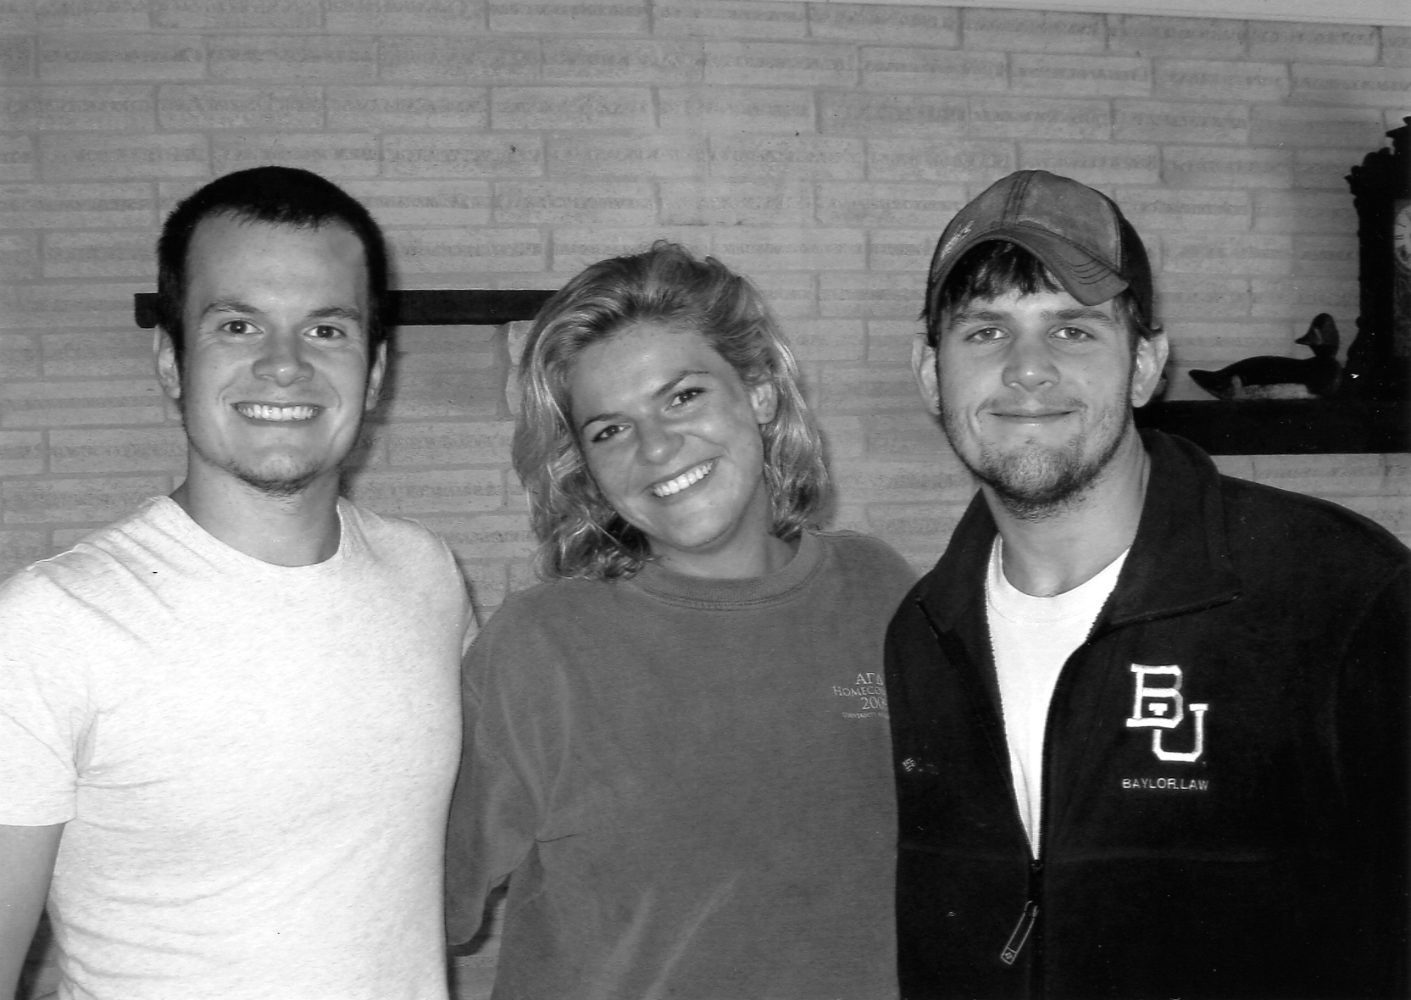
OUR MISSION
To provide leadership, information, education,
and support for planning, financial assistance,
and outreach for the conservation and
responsible development of
water for Texas.

Slide 3
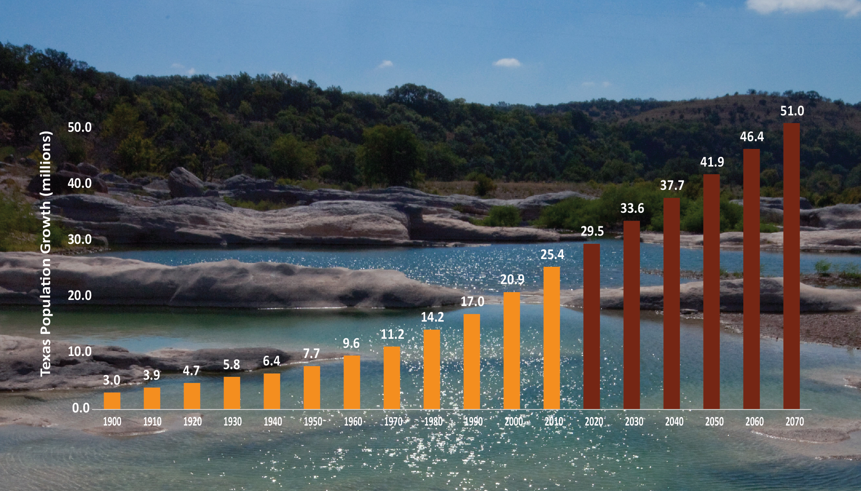
HISTORIC AND PROJECTED TEXAS POPULATION GROWTH
Texas Population (Millions)
Decade

Slide 4
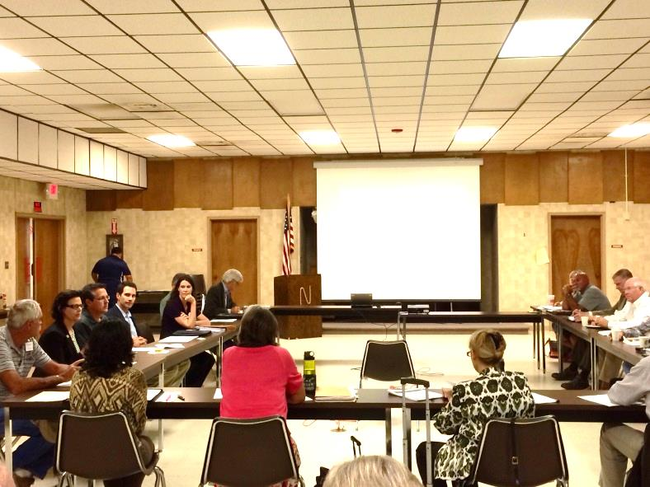
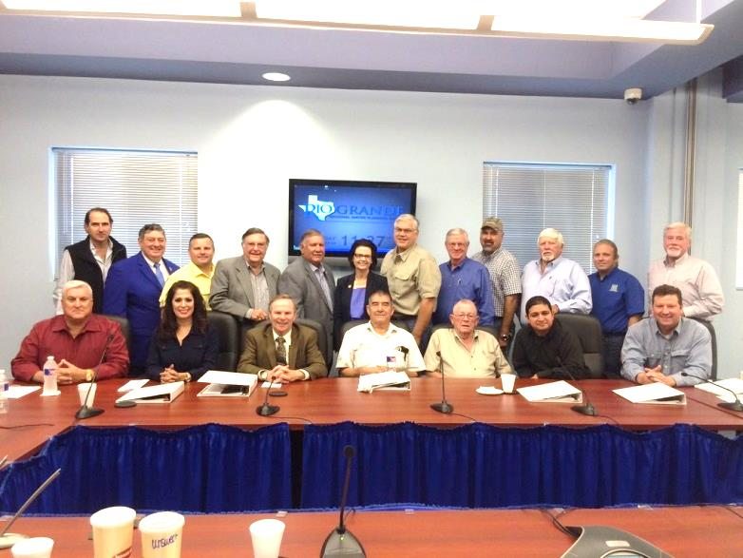
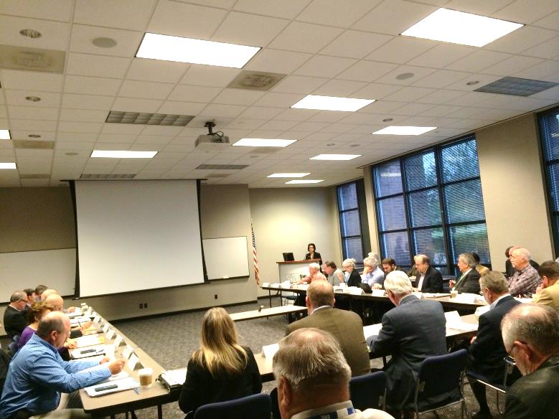
REGIONAL WATER PLANNING GROUPS
Region N
Region M
Local Political Subdivision serves as administrator
Public, consensus-driven
Local/regional decision making process
Region L

Slide 5
2017 STATE WATER PLAN

Slide 6
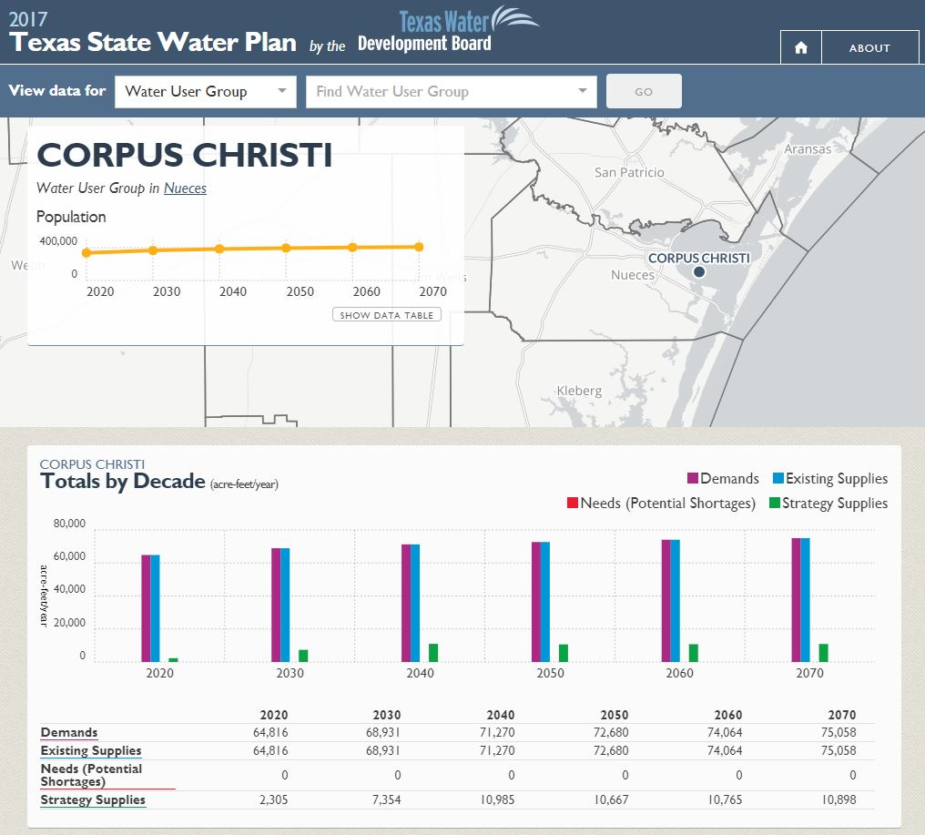
ONLINE 2017 state water plan
http://texasstatewaterplan.org

Slide 7
TOTAL SWIFT COMMITMENTS
2015
$3,793,370,000*
2016
$759,255,000
2017
$1,052,915,000
$5,605,540,000
* Reflects subsequent adjustment based on actual closings.

Slide 8
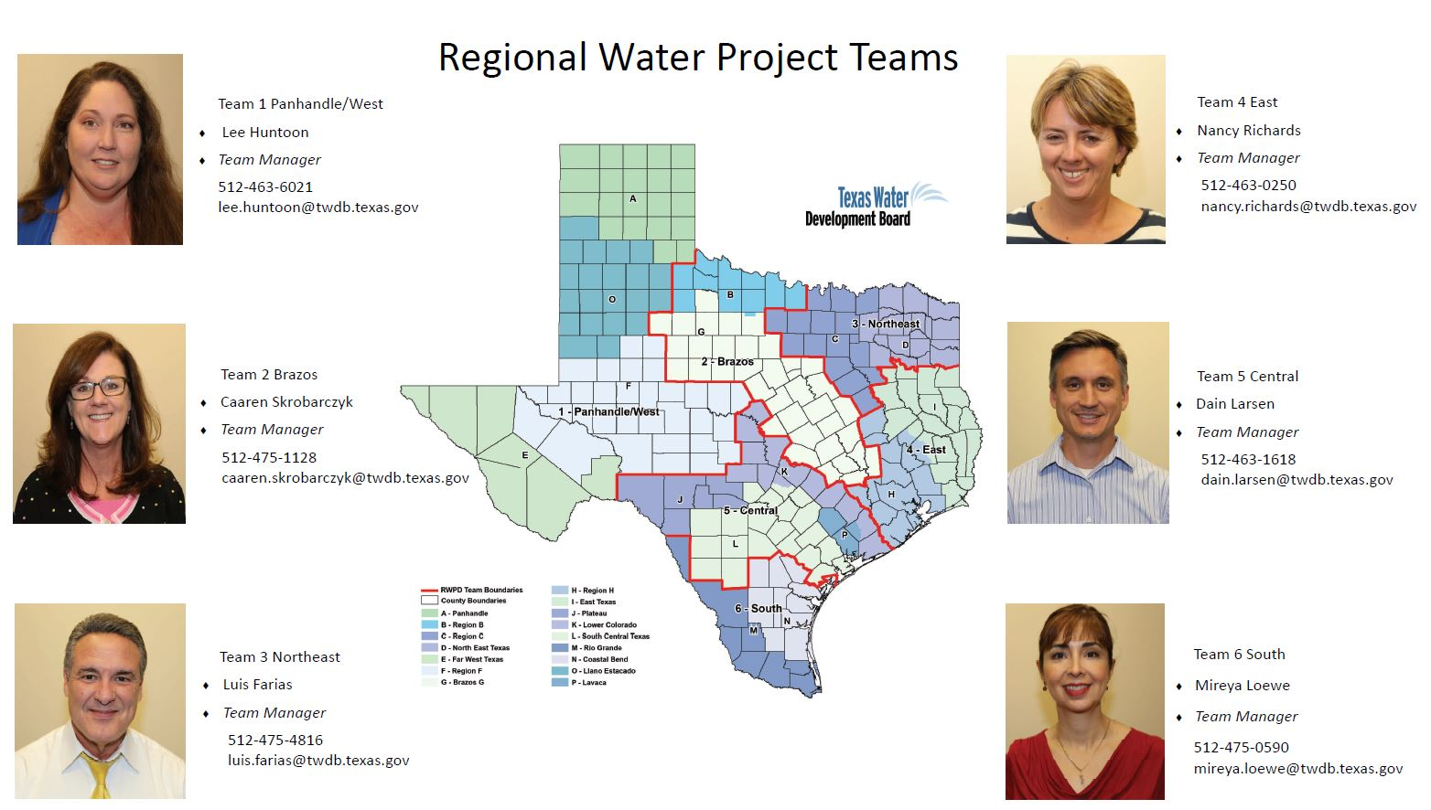
twdb regional TEAMs

Slide 9
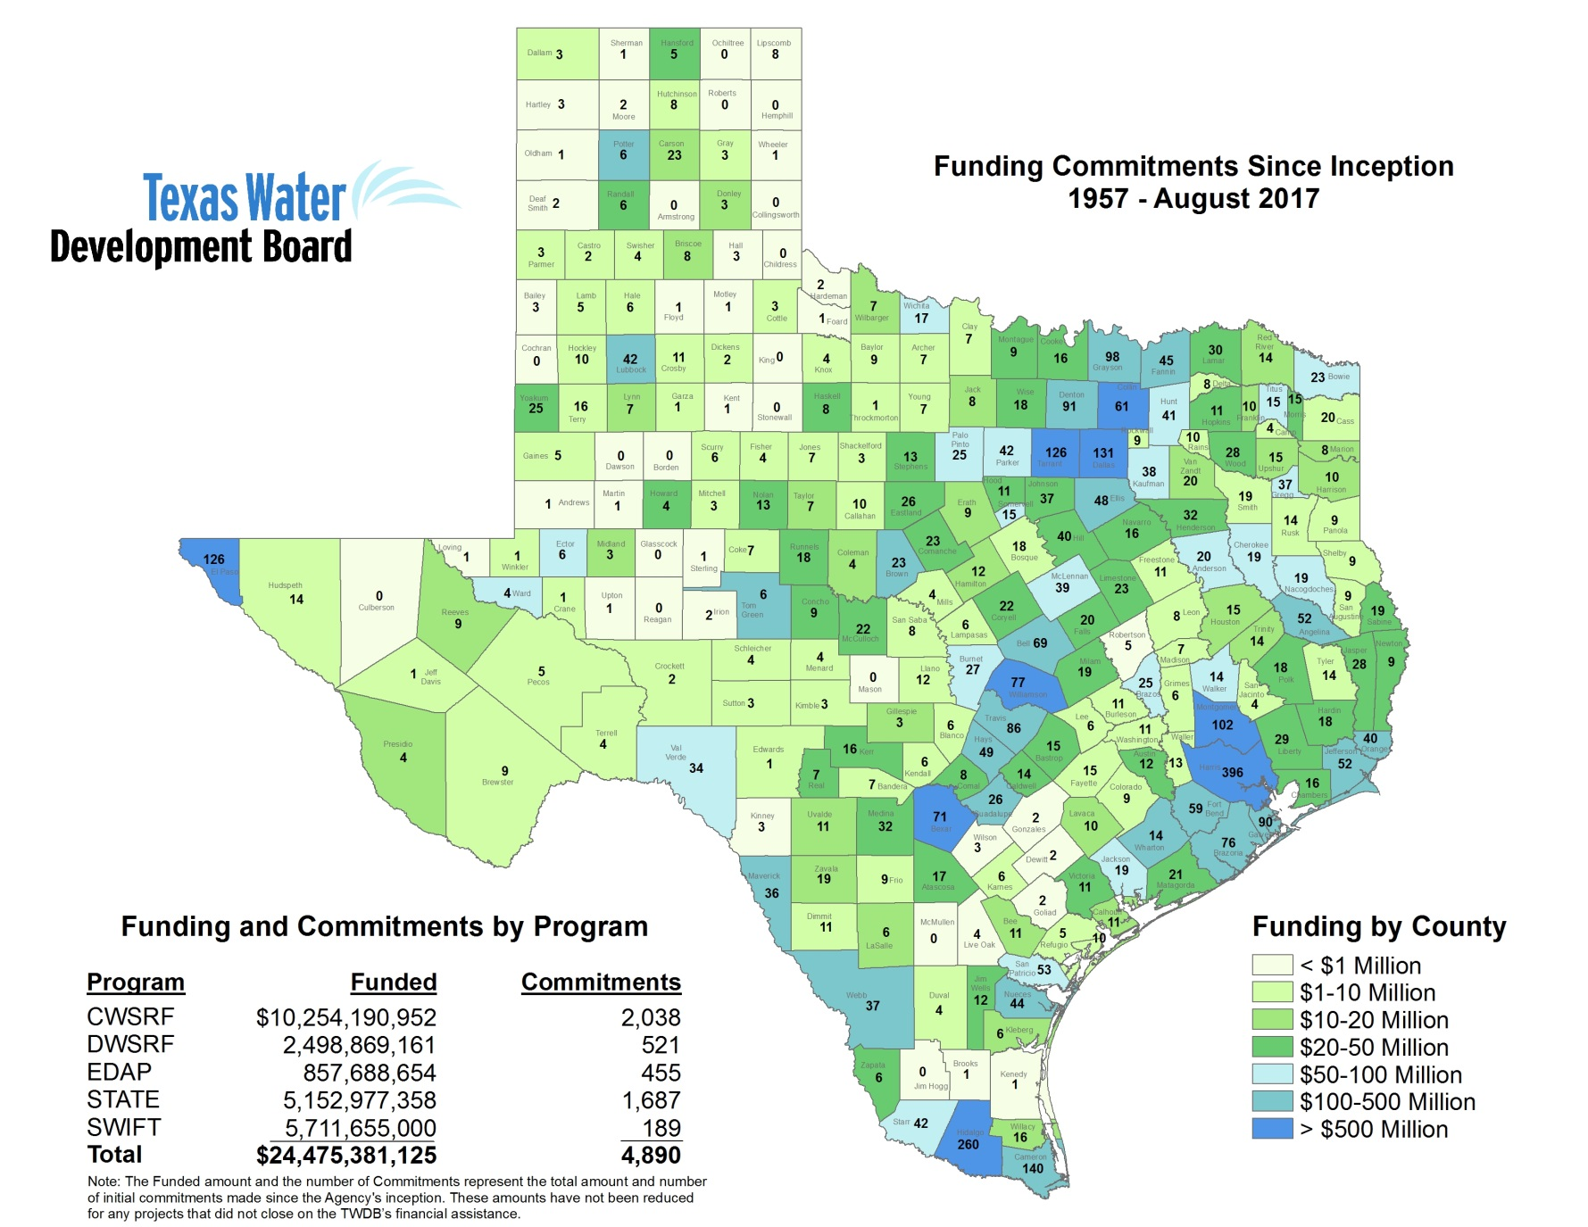
COMMUNITIES FUNDED
TWDB has committed over $24.5 BILLION in loans and grants since inception (1957)
TWDB has committed over $1 BILLION TO RURAL ENTITIES (population<10,000) in loans and grants in the last 10 years

Slide 10
HOW CAN WE PROMOTE RESILIENCY?
Conservation
Reuse
Seawater desal
Brackish groundwater desal
Aquifer storage and recovery
Aquifers
Reservoirs

Slide 11
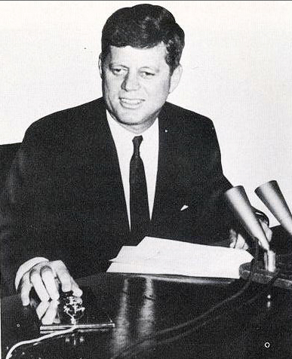
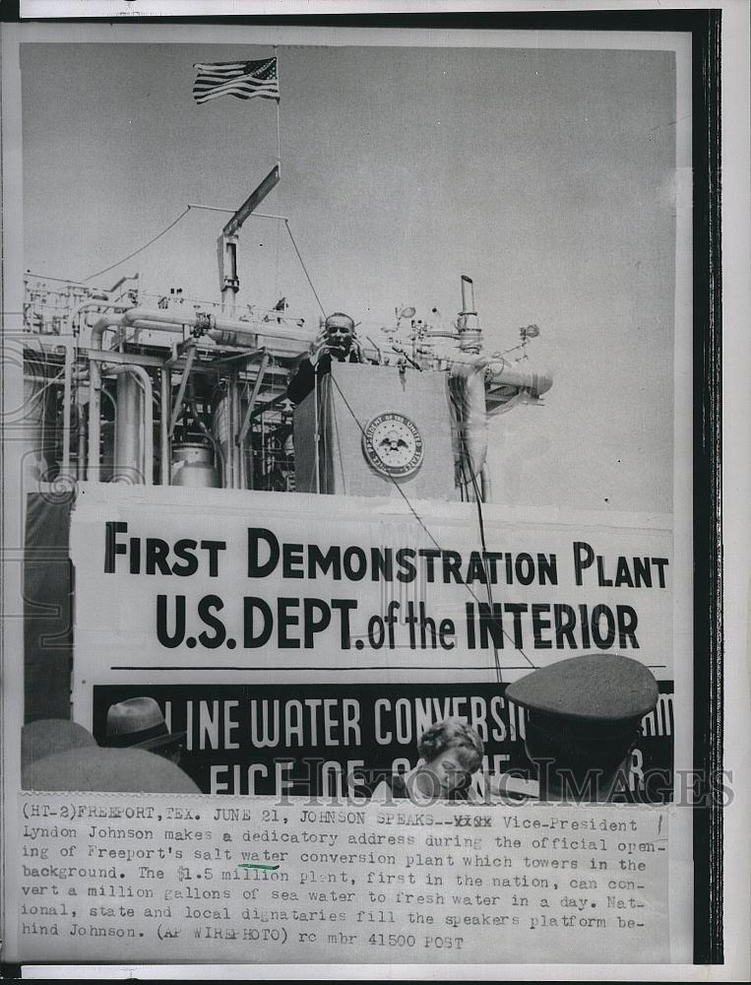
DESAL TECHNOLOGY IS NOT NEW
JFK “starting” the Freeport Plant
LBJ speaking at Plant on Opening Day
“[Desal] represents a triumph of peace and not war.”
1961

Slide 12
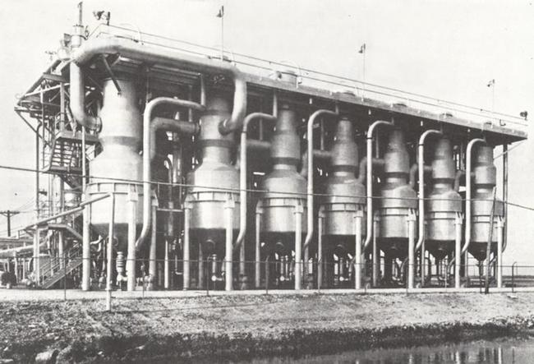
FREEPORT MULTIPLE-EFFECT DISTILLATION TEST FACILITY
1 million gallons per day
(1961 to 1973)
Dow Chemical assisted

Slide 13
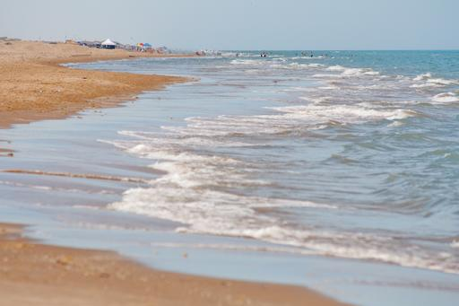
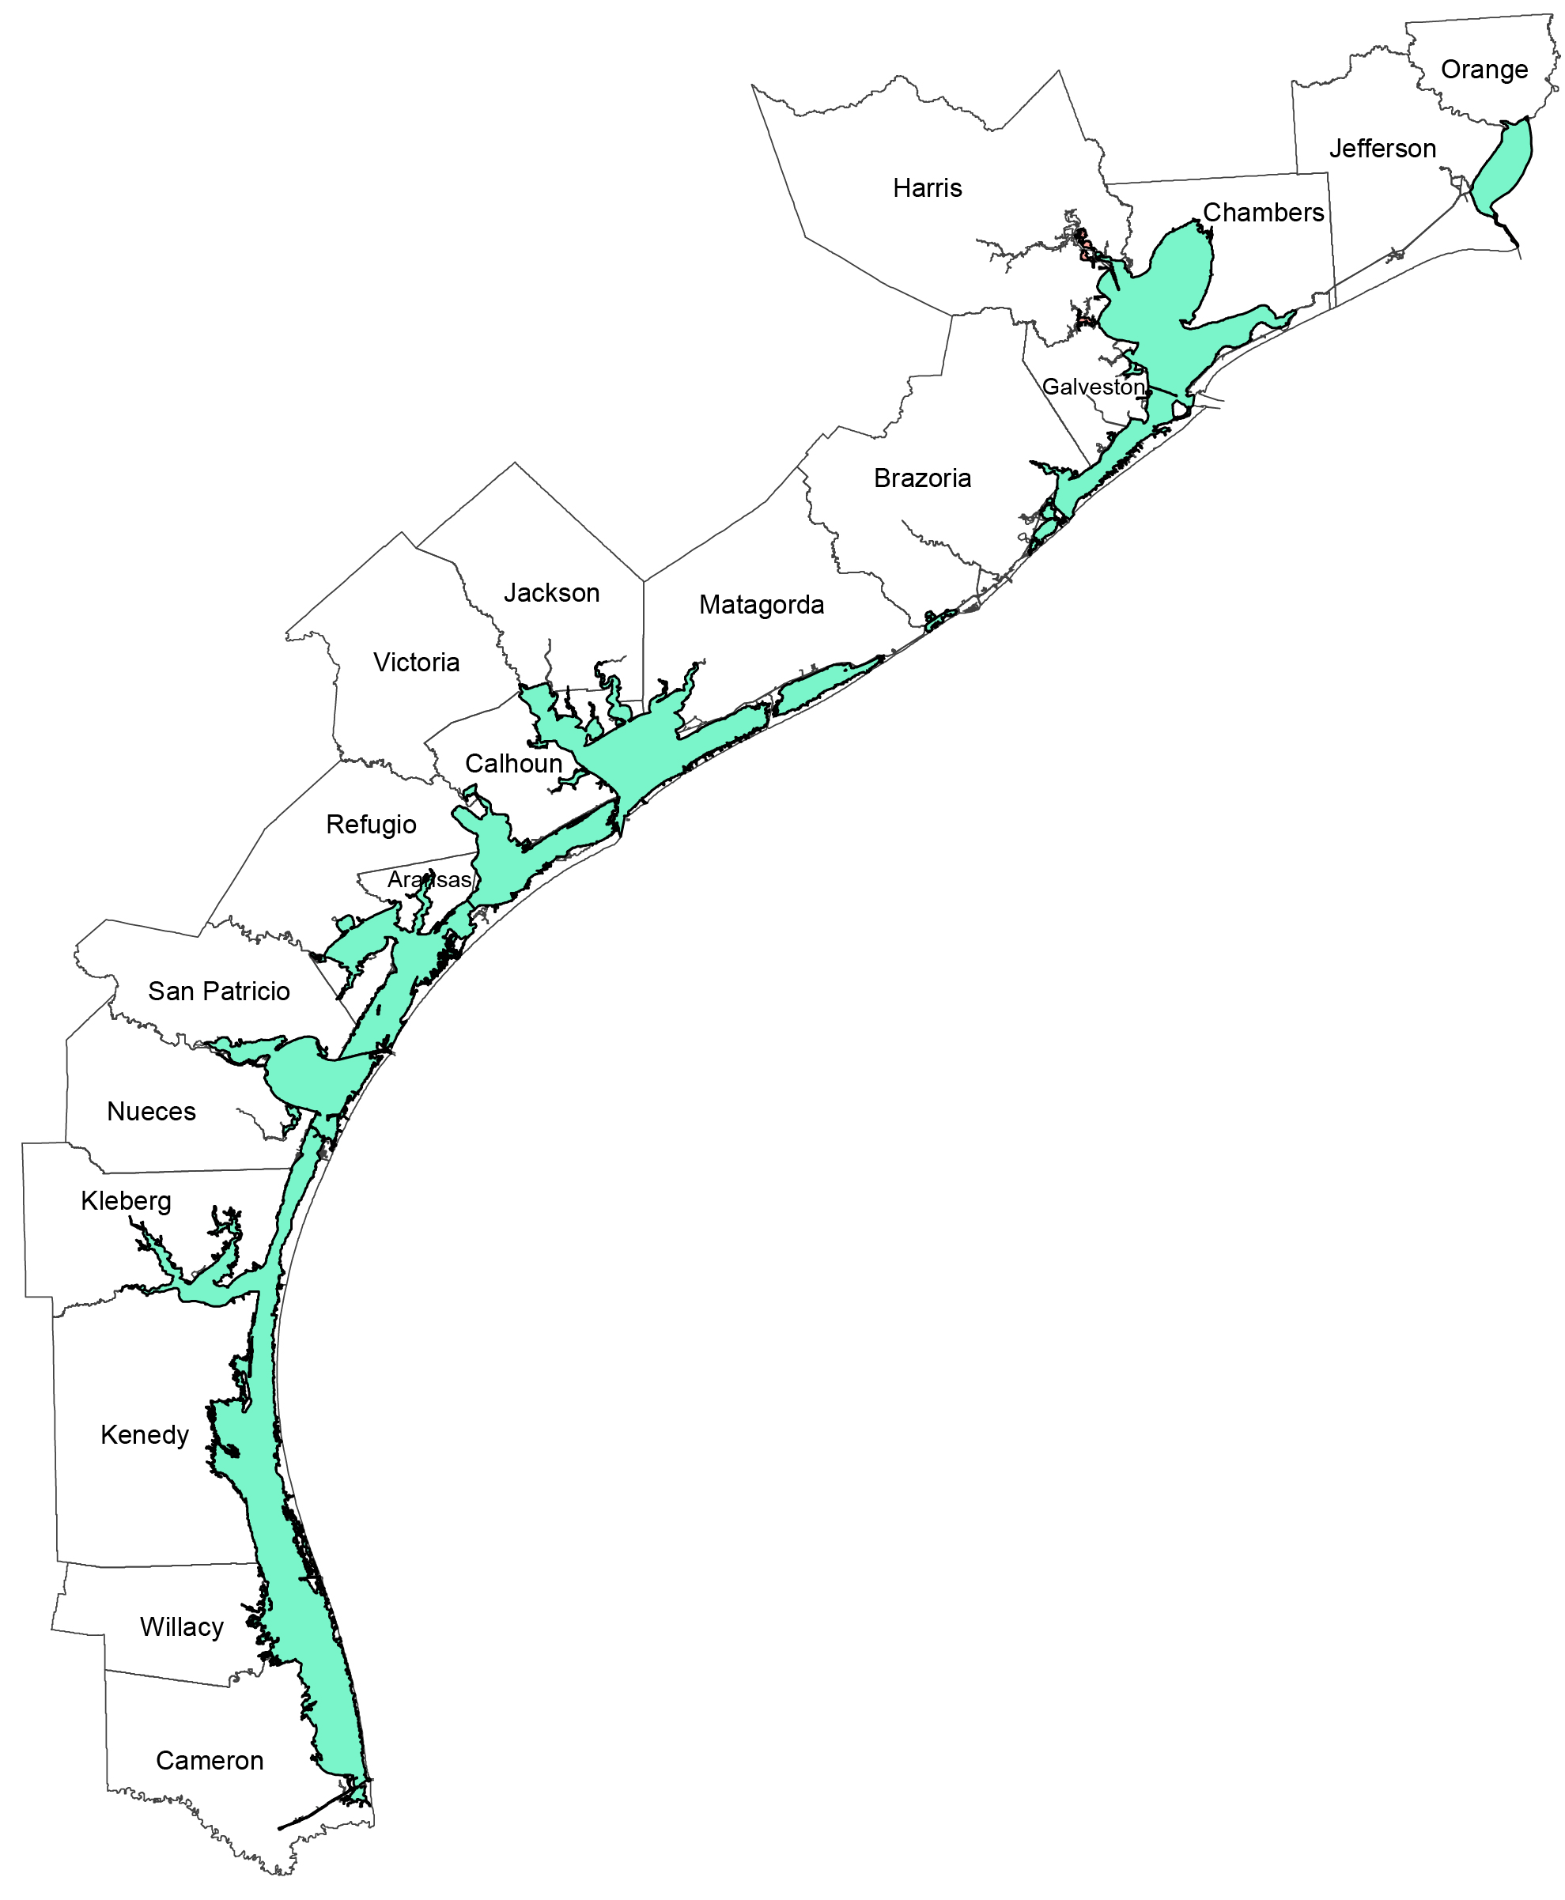
SEAWATER DESALINATION
ACCESS TO 370 MILES OF COASTLINE

Slide 14
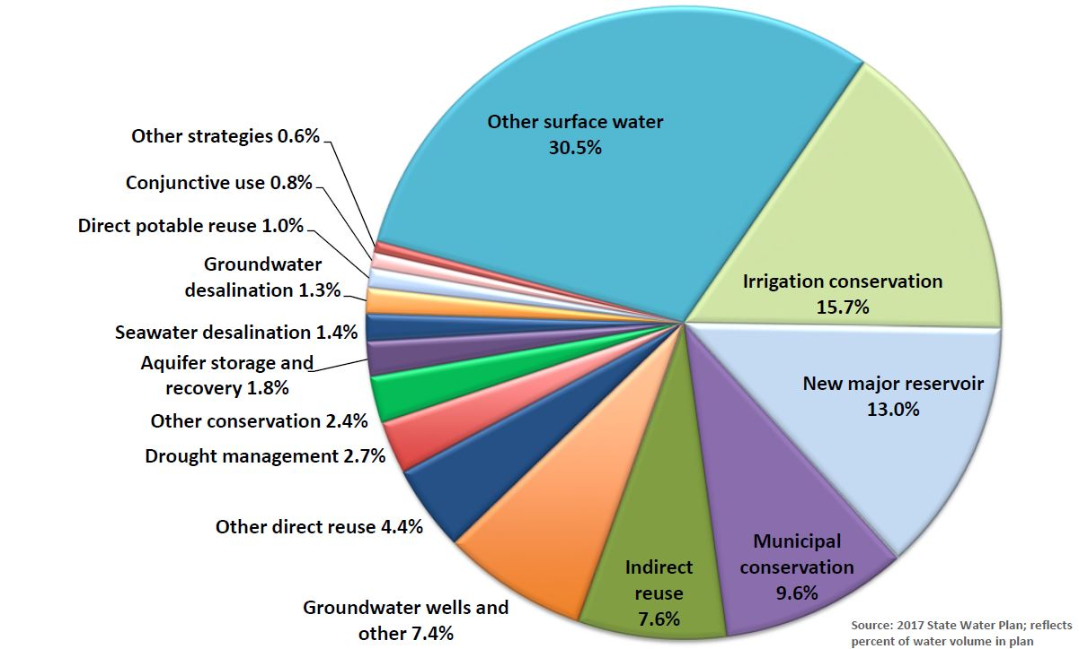
Share of Water Management Strategies in 2070

Slide 15
SEAWATER DESAL WATER MANAGEMENT STRATEGIES

Slide 16
SEAWATER DESALINATION PROJECTS
ID | REGION | PROJECT SPONSOR | PROJECT NAME | FEASIBILITY STUDY COMPLETED | PILOT STUDY COMPLETED | PROJECT LEVEL RECOMMENDATION TYPE
1 | H | Brazos River Authority | Freeport seawater desalination | Yes | -- | Recommended
2 | L | San Antonio Water System | Seawater desalination | -- | -- | Recommended
3 | L | Guadalupe Blanco River Authority | Integrated water-power project | Yes | -- | Recommended
4 | M | Brownsville Public Utilities Board | Brownsville seawater desalination demonstration | Yes | Yes | Recommended
5 | M | Brownsville Public Utilities Board | Brownsville seawater desalination implementation | Yes | Yes | Recommended
6 | N | Corpus Christi | Seawater desalination | Yes | -- | Recommended
7 | M | Laguna Madre Water District | Laguna Madre seawater desalination | Yes | Yes | Alternative
8 | M | RGRWA | RGRWA ocean desal – Phase I | -- | -- | Alternative
9 | M | RGRWA | RGRWA ocean desal - Phase II | -- | -- | Alternative
10 | M | RGRWA | RGRWA ocean desal - Phase III | -- | -- | Alternative
11 | M | RGRWA | RGRWA ocean desal - Phase IV | -- | -- | Alternative

Slide 17
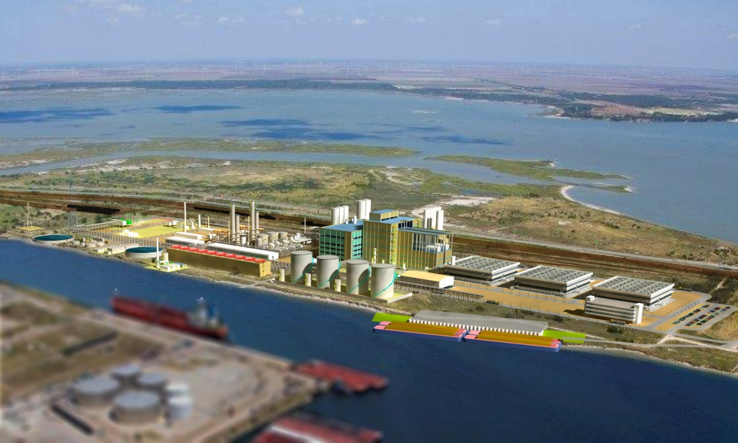
M&G RESINS USA, LLC - Corpus Christi
6 million gallons per day of seawater desalination
2 million gallons per day of water reuse
Sized to eventually produce 9 million gallons per day
Expected to start production by late 2017

Slide 18
TWDB Funded project
City of Corpus Christi
Planning of a Seawater Desalination Treatment Project
Continue evaluation
Plant siting evaluation;
Source water characterization;
Analysis of concentrate management methods;
Evaluation of cost allocation strategies;
Economic impact and cost modeling;
Public outreach;
Recommendation of a project management agency; and
Evaluation and selection of a project procurement methodology
$2,750,000 through State Water Implementation Fund for Texas (SWIFT)
Corpus Christi
TX

Slide 19
Seawater Desalination
Benefits: | Challenges:
Readily available Infinite supply Drought-proof Reliable Scalable Proven technology | Environmental impacts Brine management Cost

Slide 20
2016 BIENNIAL REPORT TO TEXAS LEGISLATURE
Report on both brackish groundwater desalination AND seawater desalination;
Identification and designation of local or regional brackish groundwater production zones

Slide 21
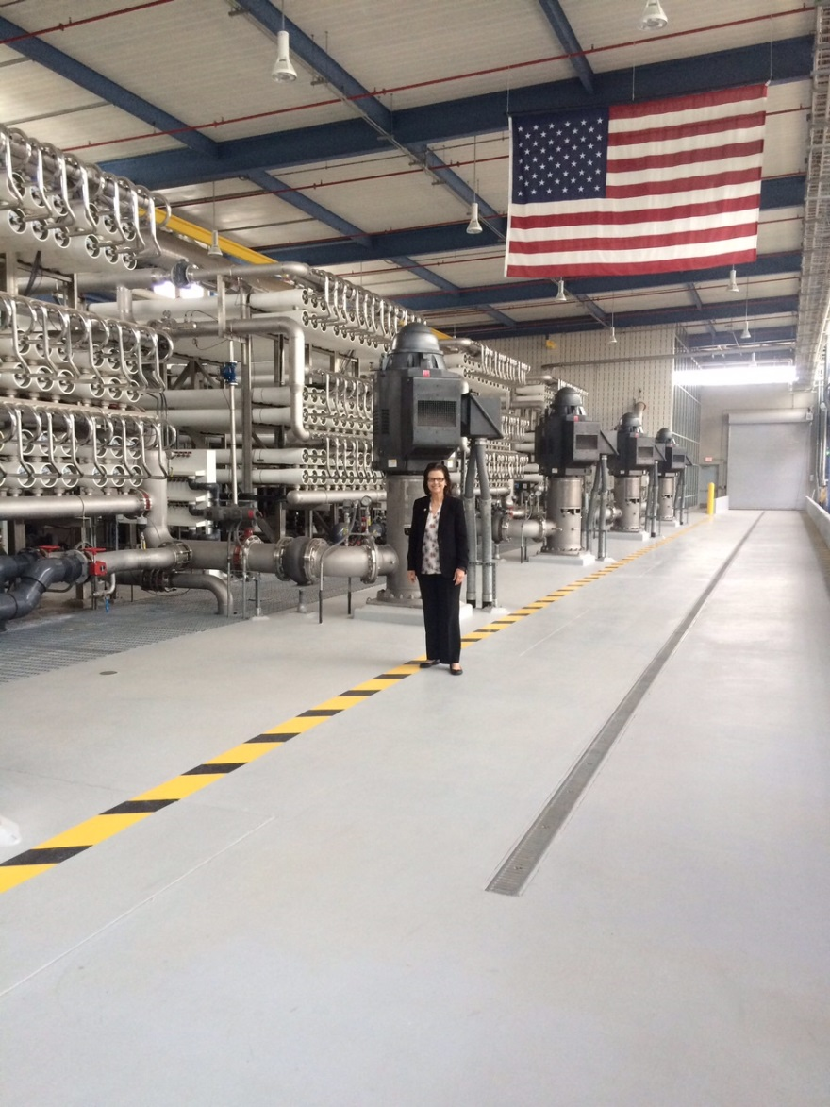
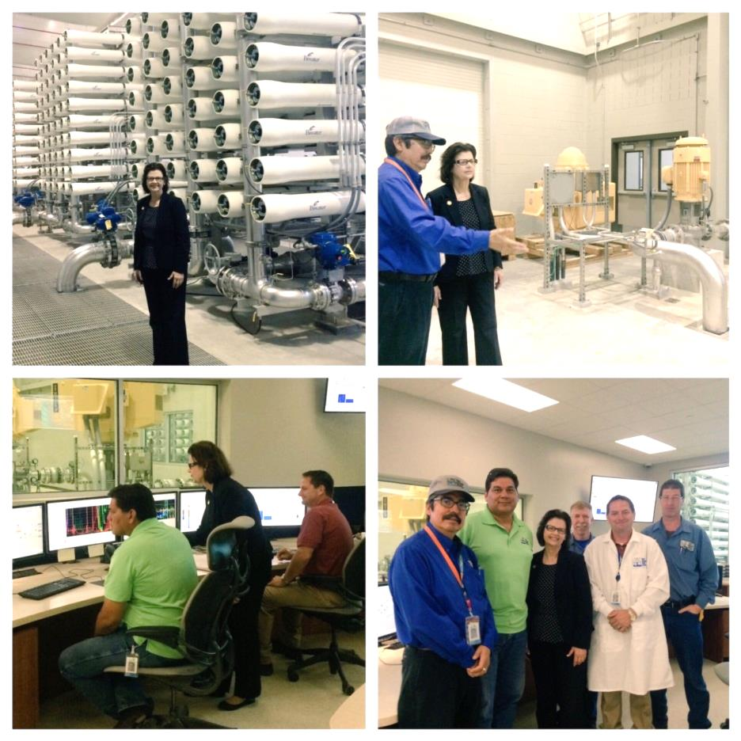
BRACKISH GROUNDWATR DESALINATION
San Antonio Water System (SAWS) H2Oaks Center – Brackish Desal Plant
Kay Bailey Hutchison Brackish Desal Plant
El Paso

Slide 22
Share of Water Management Strategies in 2070

Slide 23
BRACKISH DESAL WATER MANAGEMENT STRATEGIES

Slide 24
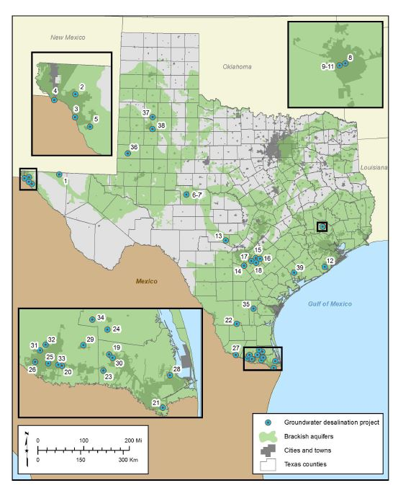
BRACKISH GROUNDWATER DESAL PLANTS 2017 STATE WATER PLAN
Regional water planning groups propose to implement 39 groundwater desalination projects

Slide 25
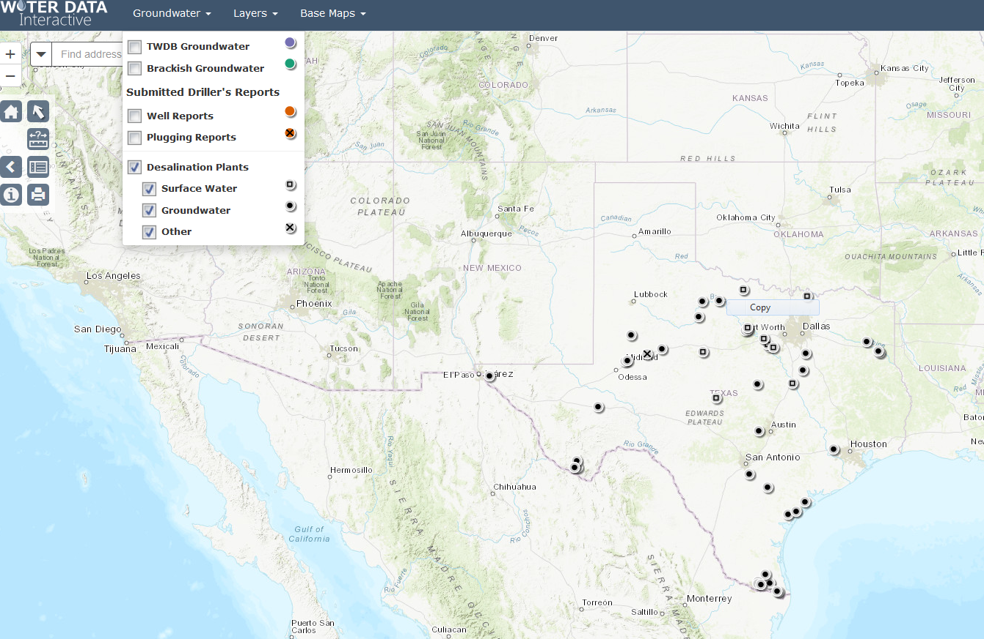
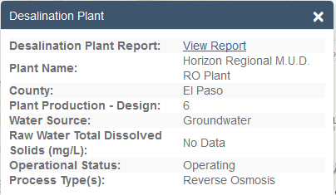
INTERACTIVE DESAL DATABASE

Slide 26
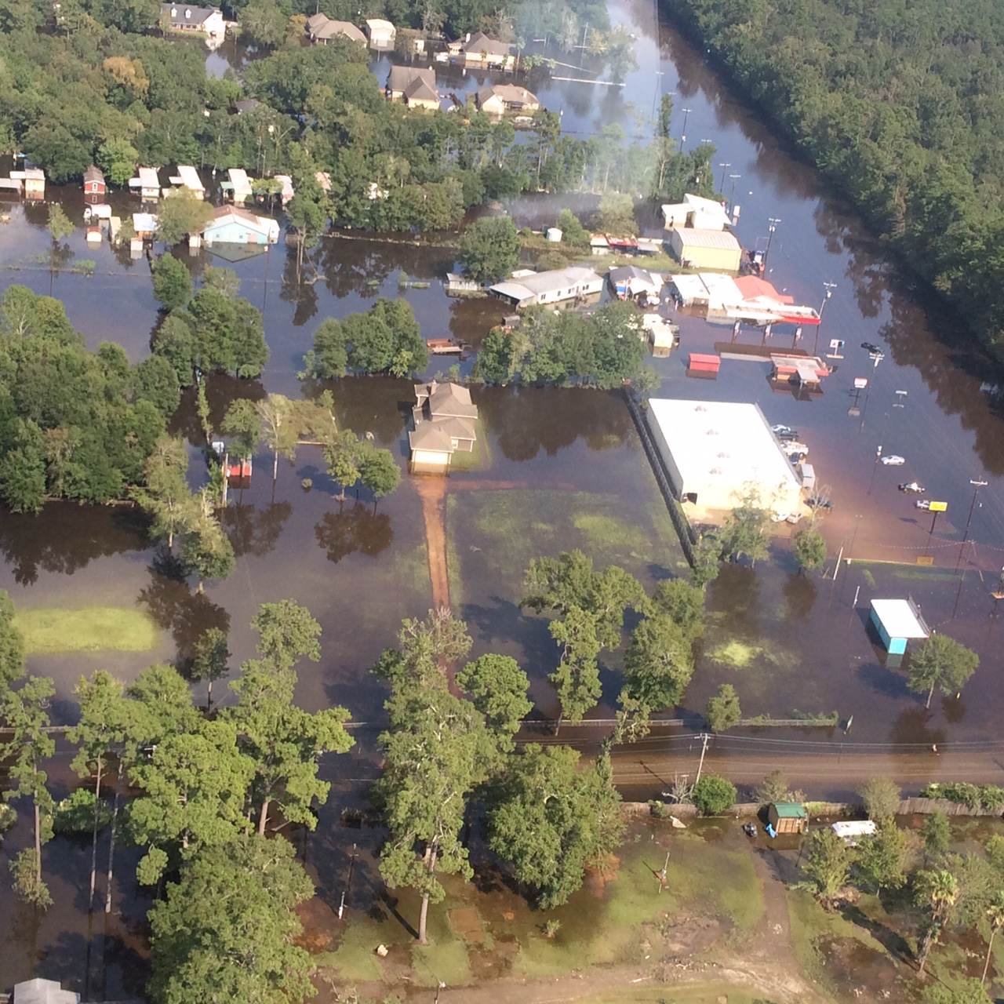
IMPACT OF HURRICANE HARVEY FLOODING – SOUTHEAST TEXAS

Slide 27
TWDB REGIONAL FINANCIAL ASSISTANCE WORKSHOPS & DISASTER recovery WORKSHOPS
Location * | Date | Building Name | Address
Yoakum | November 7, 2017 – 10 a.m. *Includes Disaster Relief Topics* | Texas Department of Transportation-Training Room | 403 Huck Street Yoakum, TX
Corpus Christi | November 30, 2017 – 10 a.m. *Disaster Recovery Topics Only* | Coastal Bend Council of Governments | 2910 Leopard Street Corpus Christi, TX
Houston | December 5, 2017 – 1 p.m. *Disaster Recovery Topics Only* | Houston-Galveston Area Council Conference Rooms B & C, 2nd Floor | 3555 Timmons Lane Houston, TX
Edinburg | December 12, 2017 – 9 a.m. | Edinburg Conference Center at Renaissance | 118 Paseo Del Prado Edinburg, TX
Beaumont | December 13, 2017 – 9 a.m. *Disaster Recovery Topics Only* | South East Texas Regional Planning Commission | 2210 Eastex Frwy Beaumont, TX
Glen Rose | January 9, 2018 – 1 p.m. | Somervell County Water District, Administrative Office-Board Room | 2099 County Road 301 Glen Rose, TX
Denton | February 6, 2018 – 9 a.m. | Public Safety Training Facility, Conference Room C | 719 Hickory Denton, TX

Slide 28
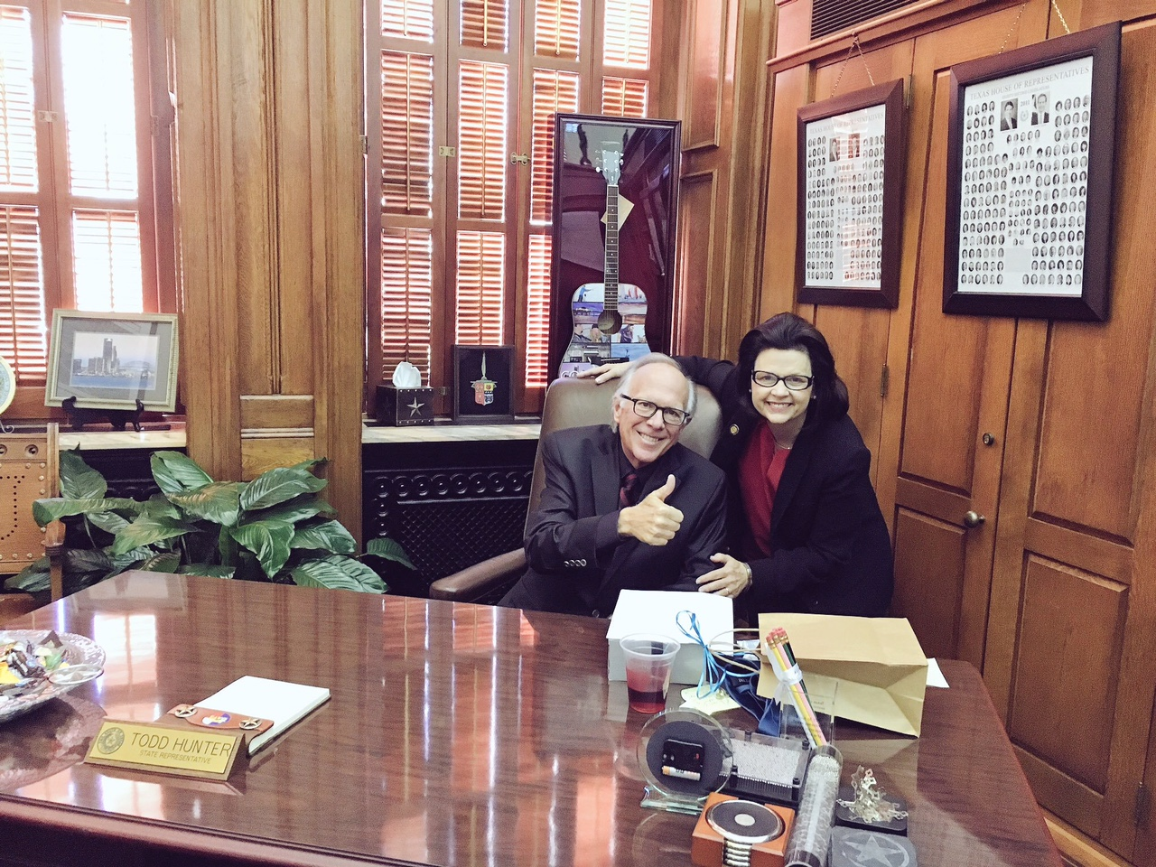
BUILDING A STRONGER TEXAS
Thank You!

Slide 29
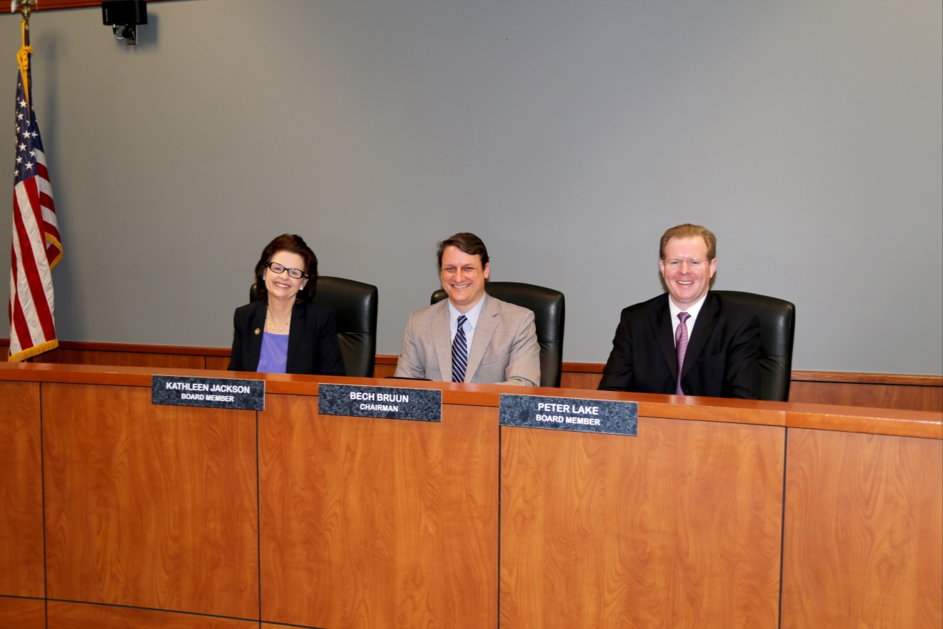
HOW TO CONTACT ME
Kathleen Jackson, P.E.
@twdb_kathleen
512.463.7847
Kathleen.Jackson@twdb.texas.gov
www.twdb.texas.gov

